Slide 1
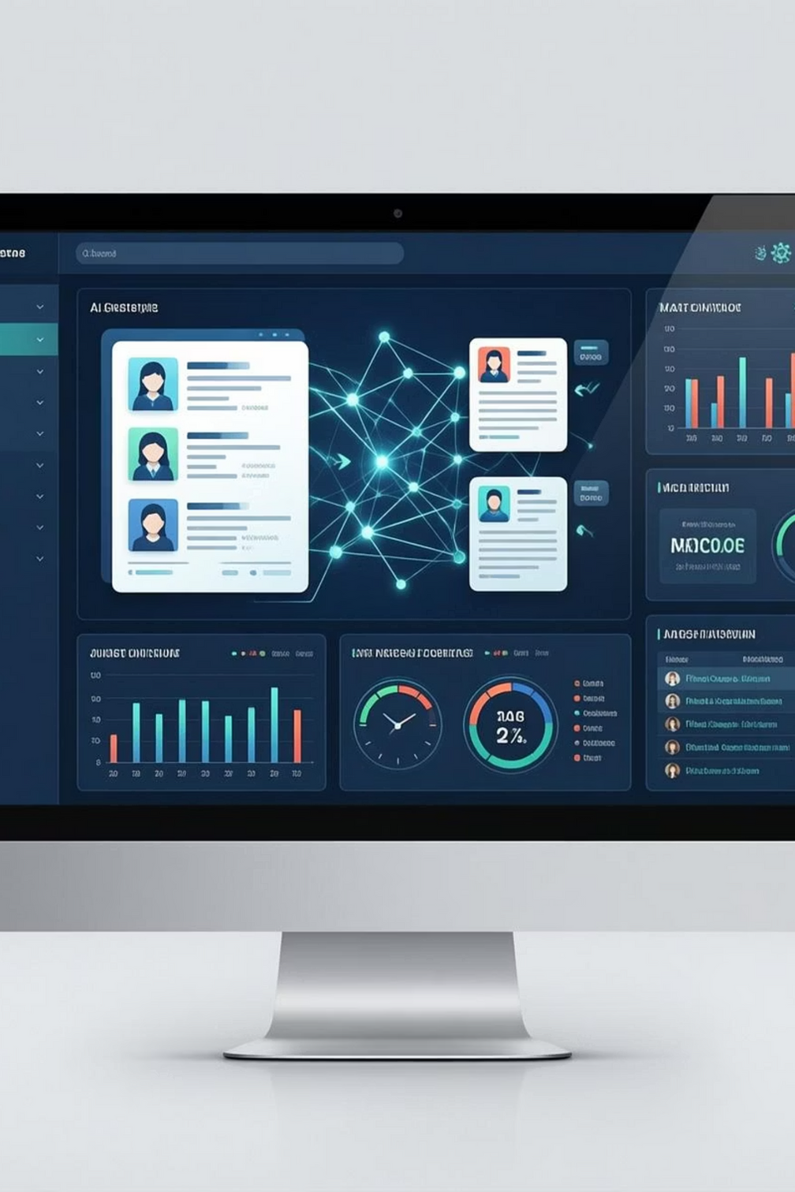

AI-Based Resume Screening & Skill Matching System
A smart recruitment support system that automatically screens resumes, matches candidate skills with job requirements, and ranks candidates based on relevance.
Developed by: Divya Arjun Pawar
Notes:
1

Slide 2
Challenges in Traditional Resume Screening
Manual screening is time-consuming and inefficient
Recruiters handle hundreds of resumes per job role
High chance of missing qualified candidates
Skill matching depends heavily on human judgment
Lack of consistency in candidate evaluation
Goal: To reduce screening time and improve accuracy using intelligent automation.
Notes:
2

Slide 3
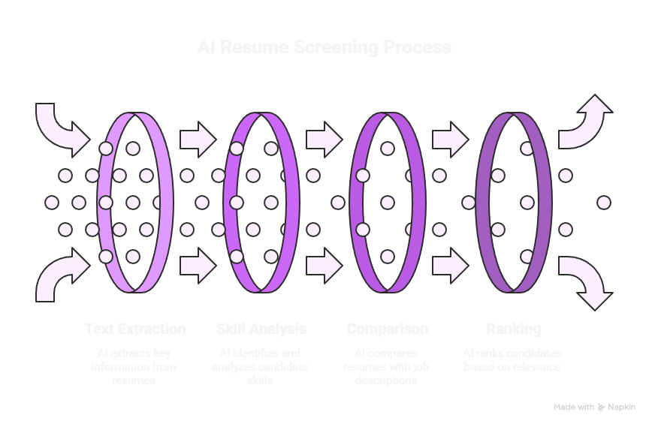
Notes:
3

Slide 4
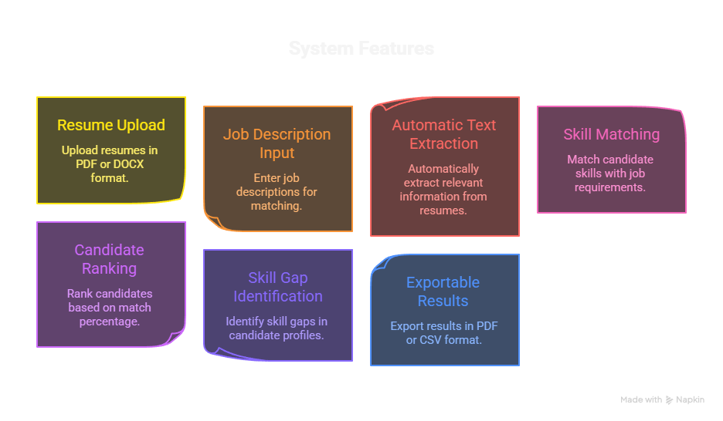
Notes:
4

Slide 5
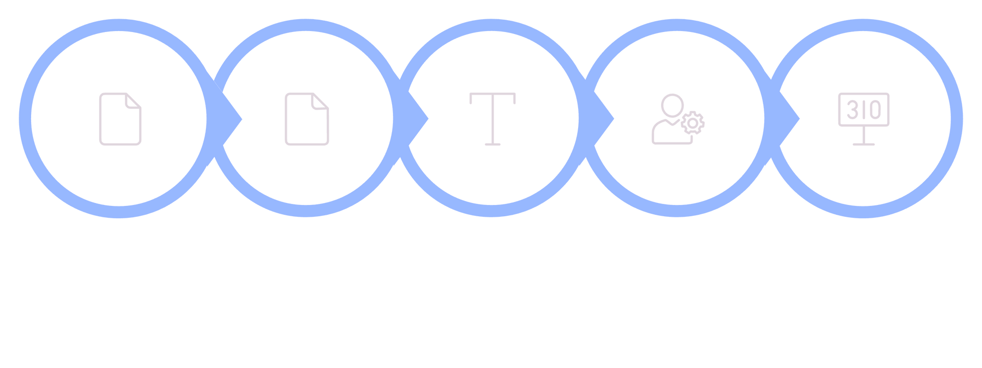





How the System Works
Identify Skills
Compute Score
Upload
Provide JD
Extract Text
Output: A clear, ranked list of candidates with skill insights.
Notes:
5

Slide 6










Benefits
Saves recruiter time
Improves hiring efficiency
Ensures unbiased screening
Easy to use and scalable
Suitable for real-world HR workflows
Conclusion
This project demonstrates how AI and NLP can enhance recruitment by automating resume screening while maintaining professional decision support for HR teams.
Notes:
6

